Slide 1
Database integration and API

Slide 2
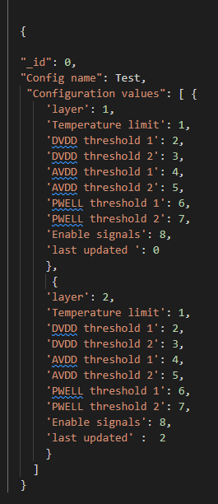
Configuration database
MongoDB
JSON format, python dictionaries
Each set is defined by its name

Slide 3
API
Generalized lower level with a package for address information
API will always concatenate data from microcontroller, only a few registers only use 8 bits
How to implement broadcast functionality?

